Slide 1
Introduction to JavaScript
Tayyaba Rashid

Slide 2
JavaScript
JavaScript is a scripting language that allows building dynamic Web pages by ensuring maximum user interactivity.
JavaScript language is an object-based language, which means that it provides objects for specifying functionalities.
In a scripting language, an object has a unique identity, state, and behavior.
The object stores its identity and state in fields (also called variables) and exposes its behavior through functions (actions).
Notes:
In real life, an object is a visible entity such as a car or a table having some characteristics and capable of performing certain actions.

Slide 3

JavaScript
State
Name, Model, Color
Behavior
Start(), accelerate() Identity
Registration #
Real World Object:

Slide 4
Scripting
Scripting refers to a series of commands that are interpreted and executed sequentially and immediately on occurrence of an event.
This event is an action generated by a user while interacting with a Web page.
A scripting language refers to a set of instructions that provides some functionality when the user interacts with a Web page.
Scripting languages are often embedded in the HTML pages to change the behavior of the Web pages according to the user’s requirements.

Slide 5
Scripting
Scripting
Client-side Scripting
Server-side Scripting
Notes:
Client side:
Refers to a script being executed on the client’s machine by the browser.
Server side:
Refers to a script being executed on a Web server to generate dynamic HTML pages.

Slide 6
Client-Side JavaScript
A Client-side JavaScript is executed by the browser on the user’s machine.
A client-side script might contain instructions for the browser to handle user interactivity.
These instructions might be to change the look or content of the Web page based on the user inputs.
Examples include displaying a welcome page with the user name, displaying date and time, validating that the required user details are filled, and so on.

Slide 7
Client-Side JavaScript
Following figure displays the output of a Client-Side JavaScript:

Slide 8
Server-Side JavaScript
A Server-side JavaScript is executed by the Web server when an HTML page is requested by a user and the output is displayed by the browser.
A server-side JavaScript can interact with the database, fetch the required information specific to the user, and display it to the user.
Server-side scripting fulfills the goal of providing dynamic content in Web pages.

Slide 9
Server-Side JavaScript
Following figure displays the output of a Server-Side JavaScript:

Slide 10
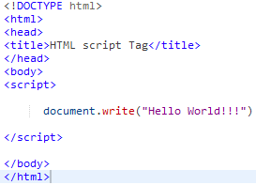

<script> tag
The HTML <script> tag is used for declaring a script (such as JavaScript) within your HTML document.
The <script> tag defines a script for an HTML page to make them interactive.
Output

Slide 11
JavaScript Variables
Variables can be thought of as named containers. You can place data into these containers and then refer to the data simply by naming the container.
Before you use a variable in a JavaScript program, you must declare it. Variables are declared with the var keyword.
Syntax:
^{where,}
var: Is the keyword in JavaScript.
variableName: Is a valid variable name.
^{var <variableName>;}

Slide 12
JavaScript Variables
The Code Snippet declares two variables namely, stdID and stdName and assign values to them.
^{var stdID;}
^{var stdName;}
^{stdID = 50;}
^{stdName = “David Fernando”;}
The Code Snippet demonstrates how to declare and initialize multiple variables in a single statement in JavaScript:
^{var stdName = David,} ^{stdAge = 15;}

Slide 13
Variable Naming Rules
JavaScript is a case-sensitive language.
The variables X and x are treated as two different variables.
JavaScript consists of certain rules for naming a variable:
In JavaScript, a variable name
can consist of digits, underscore, and alphabets.
must begin with a letter or the underscore character.
cannot begin with a number and cannot contain any punctuation marks.
cannot contain any kind of special characters such as +, *, %, and so on.
cannot contain spaces.
cannot be a JavaScript keyword.

Slide 14
Data Types in JavaScript
To identify the type of data that can be stored in a variable, JavaScript provides different data types.
Data types in JavaScript are classified into two broad categories:
Primitive Data types:
contain only a single value such as a number or a string.
Boolean
var x = true;
Null
var person = null;
Number
var length = 16;
String
var lastName = “xyz";

Slide 15
Data Types in JavaScript
Composite Data types:
Stores a collection of multiple related values.
In JavaScript all composite data types are treated as objects.
Objects
var x = {firstName:“abc", lastName:“xyz"};
Functions
function myFunction(){
alert("Hello World");
}
Arrays
var cars = [“Corolla", “Mercedes", "BMW"];

Slide 16
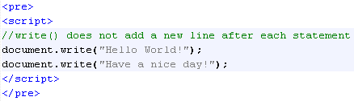

Methods
Each object in JavaScript consists of methods, that fulfill a specific task.
JavaScript allows you to display information using the methods of the document object.
There are two methods of the document object, that display any type of data in the browser. These methods are as follows:
write(): Displays any type of data.
Output:

Slide 17
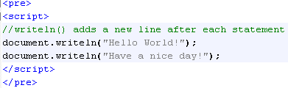

Methods
writeln(): Displays any type of data and appends a new line character.
Output:

Slide 18
Built-in Functions
A function is a piece of code that performs some operations on variables to fulfill a specific task.
It takes one or more input values, processes them and returns an output value.
Following are the built-in JavaScript functions:
alert()
confirm()
prompt()
parseInt()
parseFloat()
eval()
isNaN()

Slide 19
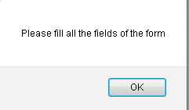

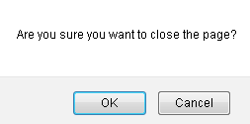

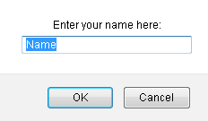

Built-in Functions
alert()
confirm()
prompt()

Slide 20
Events
An event occurs when a user interacts with the Web page.
Some of the commonly generated events are mouse clicks, key strokes, and so on.
The process of handling these events is known as event handling.
Following figure displays the event:

Slide 21
Event Handling
Event handling is a process of specifying actions to be performed when an event occurs. This is done by using an event handler.
An event handler is a scripting code or a function that defines the actions to be performed when the event is triggered.
When an event occurs, an event handler function that is associated with the specific event is invoked.

Slide 22
Event Handling
Following figure displays event handling:

Slide 23
Keyboard Events
Keyboard events are the events that occur when a key or a combination of keys are pressed or released from a keyboard.
These events occur for all keys of a keyboard.
The different keyboard events are as follows:
Onkeydown
Onkeyup
Occurs when a key is pressed down.
Occurs when a key is pressed and released.
Onkeypress
Occurs when the key is released.

Slide 24
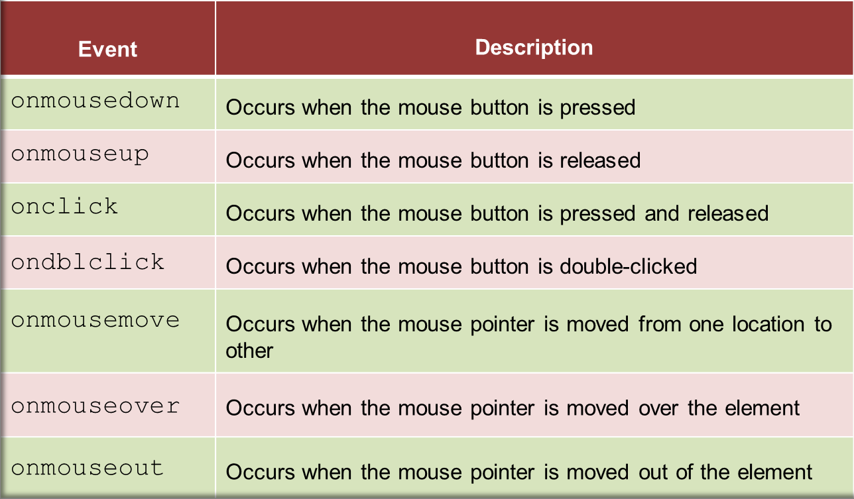
Mouse Events
Mouse events occur when the user clicks the mouse button.
Following table lists the mouse events:

Slide 25
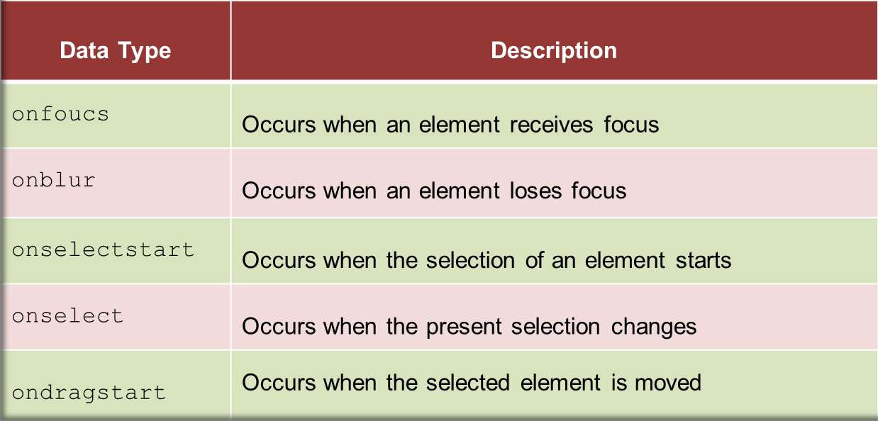
Focus & Selection Events
The focus events determine the activation of various elements that uses the element.
The selection events occur when an element or a part of an element within a Web page is selected.
Following table lists the focus and selection events:

Slide 26
Decision-making Statements
Decision-making statements allow implementing logical decisions for executing different blocks to obtain the desired output.
They execute a block of statements depending upon a Boolean condition that returns either true or false.
JavaScript supports four decision-making statements:
if
if-else
if-else-if
switch

Slide 27
If Statement
Executes a block of statements based on a logical Boolean condition.
If this condition is true, the block inside if statement is executed.
If the condition is false, the block after the if statement is not executed and the immediate statement after the if block is executed.
if (condition)
{ block of code to be executed if the condition is true; }

Slide 28
If-else Statement
Sometimes it is required to define a block of statements to be executed when a condition is evaluated to false.
if (condition)
{ block of code to be executed if the condition is true; }
else
{ block of code to be executed if the condition is false; }

Slide 29
If-else-if Statement
Allows you to check multiple conditions and specify a different block to be executed for each condition.
Flow of these statements begins with the if statement followed by multiple else if statements and finally by an optional else block.
if (condition1) { block of code to be executed if condition1 is true }
else if (condition2) { block of code to be executed if the condition1 is false and condition2 is true }
else { block of code to be executed if the condition1 is false and condition2 is false }

Slide 30
Switch-case Statement
A program becomes quite difficult to understand when there are multiple if statements.
To simplify coding and to avoid using multiple if statements, switch-case statement can be used.
switch-case statement allows comparing a variable or expression with multiple values.
switch(expression) { case n: code block break; case n: code block break; default: default code block }

Slide 31
Operators and their types
Operators help in simplifying expressions.
JavaScript provides a predefined set of operators that allow performing different operations.
JavaScript operators are classified into six categories based on the type of action they perform on operands:
^{Arithmetic operators}
^{Relational operators}
^{Logical operators}
^{Assignment operators}
^{Bitwise operators}
^{Special operators}

Slide 32
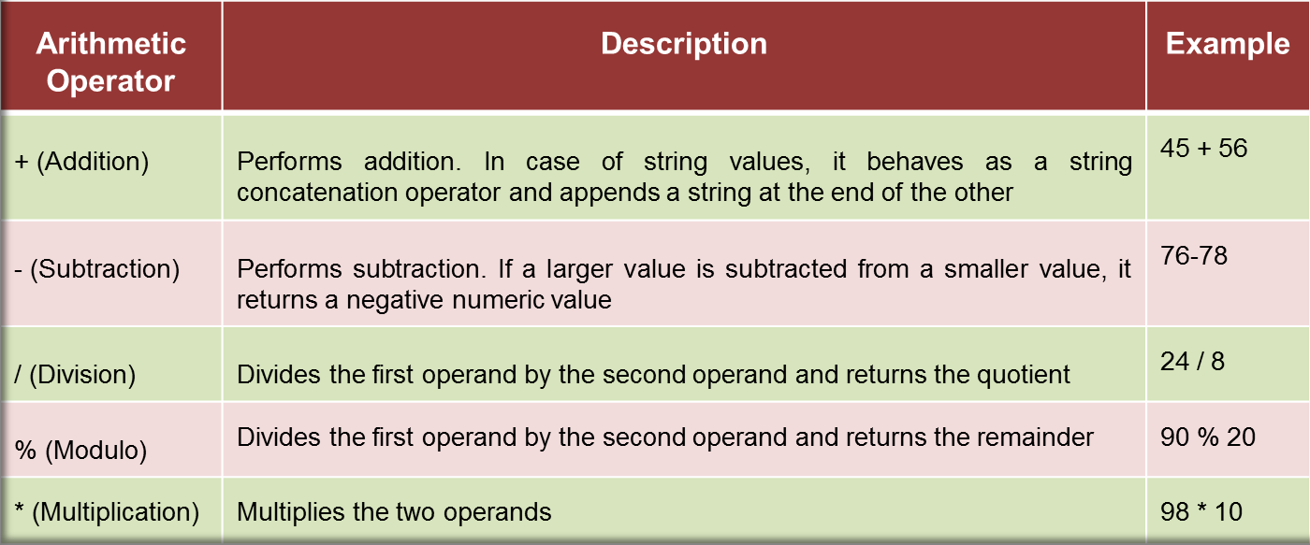
Arithmetic Operators
Are binary operators.
Perform basic arithmetic operations on two operands.
Operator appears in between the two operands, which allow you to perform computations on numeric and string values.

Slide 33
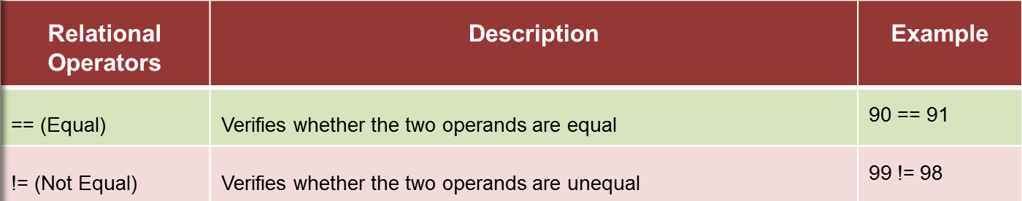
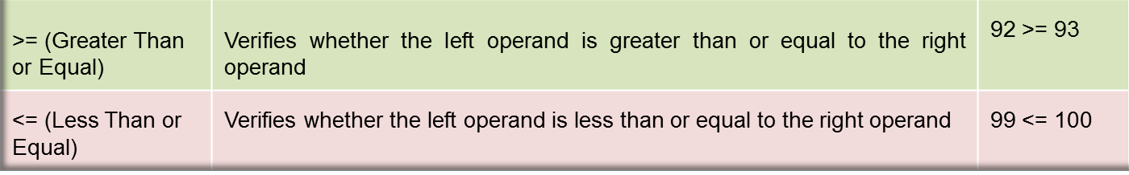
Relational Operators
Are binary operators that make a comparison between two operands.
After making a comparison, they return a boolean value namely, true or false.

Slide 34
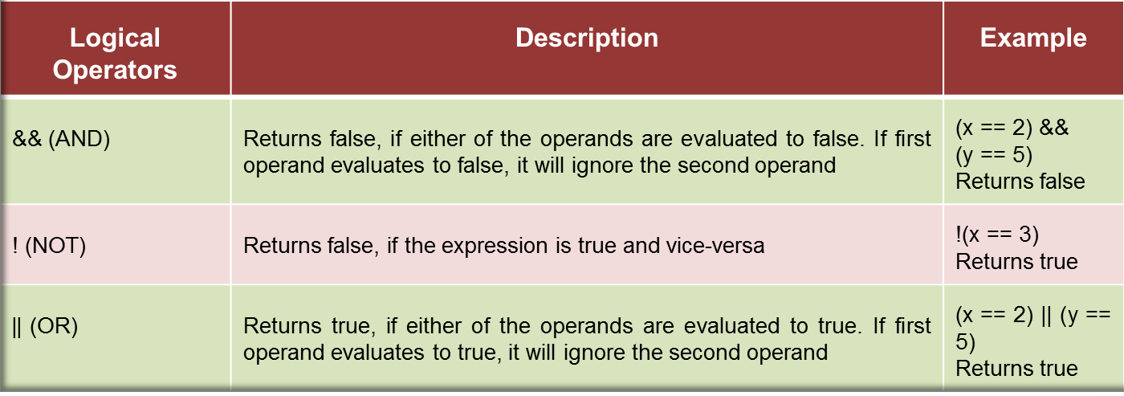
Logical Operators
Are binary operators that perform logical operations on two operands.
They belong to the category of relational operators, as they return a boolean value.

Slide 35
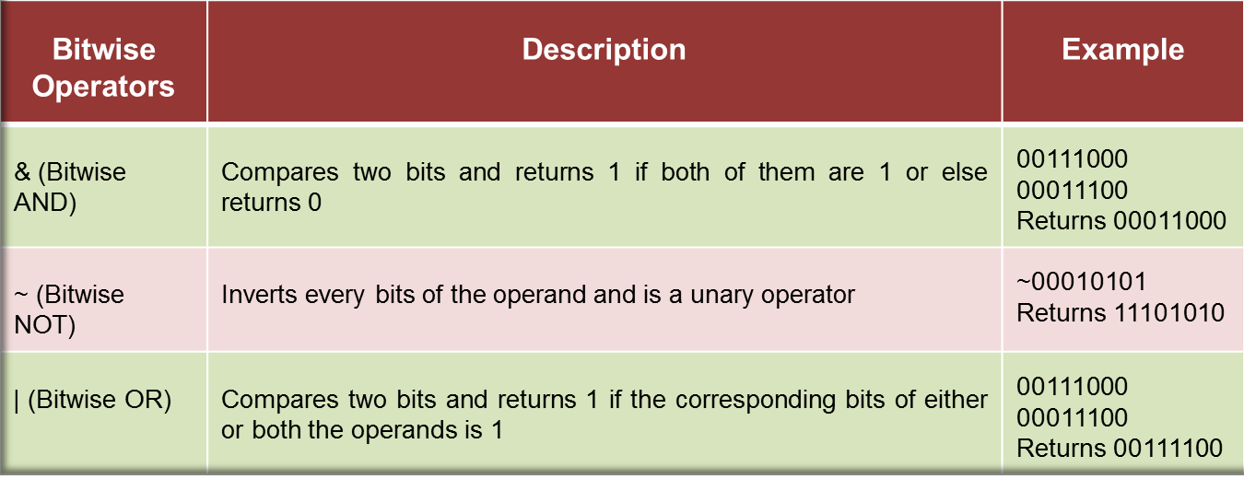
Bitwise Operators
Represent their operands in bits (zeros and ones) and perform operations on them.
56
28

